Slide 1
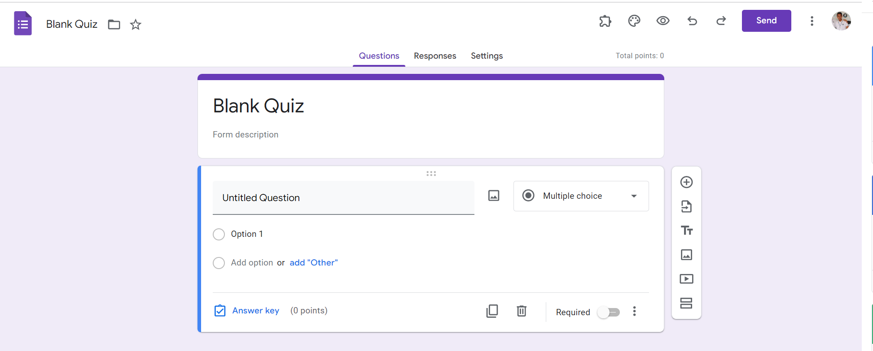
Identify root components of website below

Slide 2
Flex: 0 nav
Flex: 1 content

Slide 3
Flex 1
Flex 2
Flex 3
Nav-left
Nav-content
Nav-right

Slide 4
Flex 1
Flex 2
Flex 3
icon
logo
icon
icon
icon
icon
icon
icon
icon
text
icon
icon
text
text
text
text

Slide 5
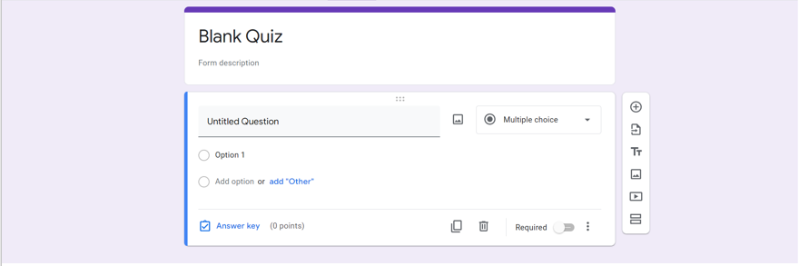
Card 1
Card 2
card3

Slide 6
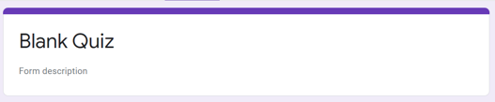
logo
text

Slide 7
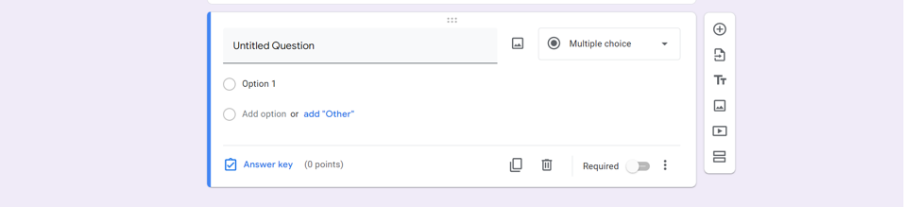
icon
icon
text
icon
icon
text
icon
icon
input
text
icon
input
text
icon
icon
text
icon
text
icon
icon
text
icon
icon
icon

